Slide 1
Java
Java 8 and Java 17

Slide 2
Introduction
Basics (Prerequisites)
Classes
Objects
Constructor
OOPs concepts - Abstraction, Encapsulation, Inheritance, Polymorphism
JDK, JRE, JVM
Variables
Access Modifiers
Type Casting
Java Collections - List, Queue, Set, Map
ENUM, POJO
Memory Management
Exception Handling
Reflections

Slide 3
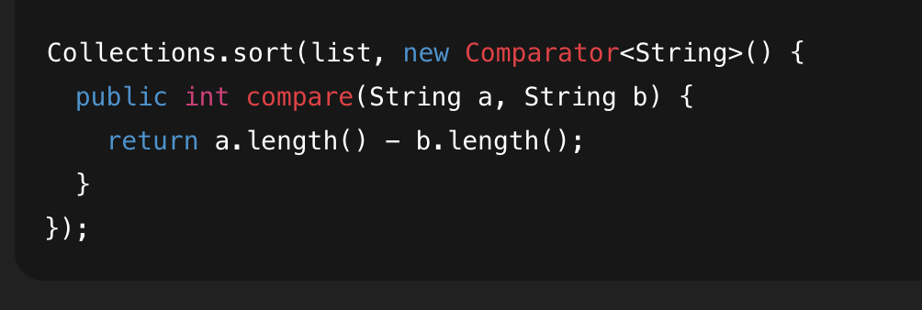
Issues Earlier
Verbose & boilerplate-heavy code
No easy way to pass behavior (functions)
Collections required manual looping
Interfaces couldn’t evolve
Poor support for parallel processing
null used to represent “absence” → runtime failures

Slide 4
Java 8
Interfaces
Lambda expression
Stream API
Predicates
Optional
Java 17
Records
Sealed Classes
Text Blocks
instanceof

Slide 5
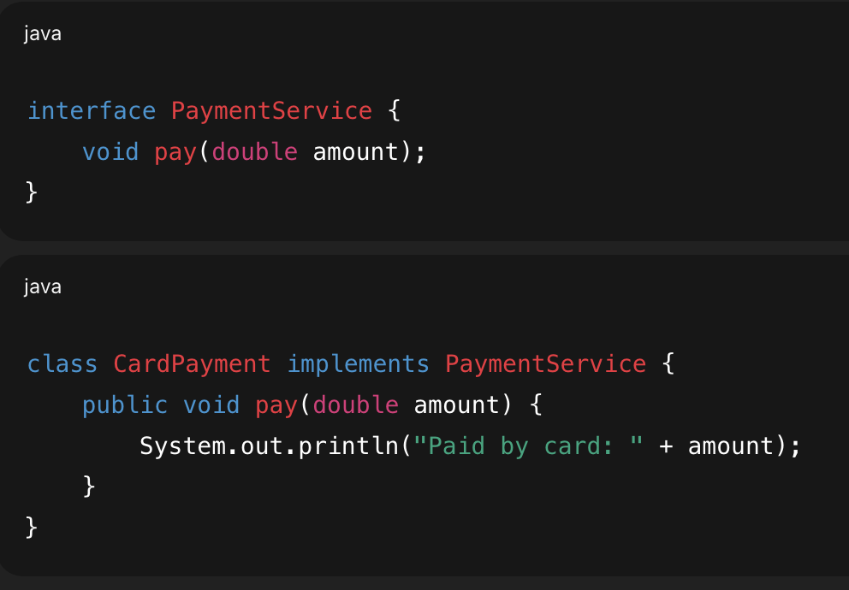
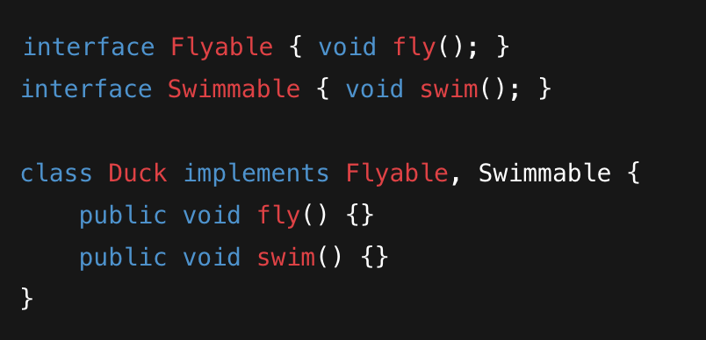
Interface
An interface defines a contract: what a class must do, not how.
It supports abstraction and multiple inheritance of behavior (via implementation).
Methods are public and abstract by default
Fields are public static final (constants only)
No method implementations allowed
A class can implement multiple interfaces

Slide 6
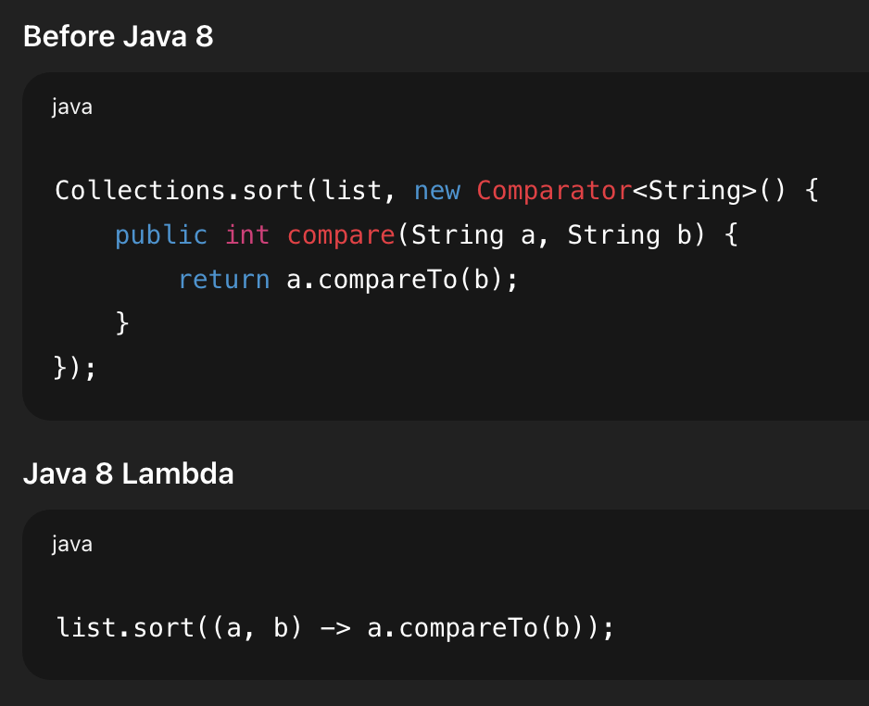
Lambda
A lambda expression is a short way to pass behavior (function) as data.
It removes anonymous class boilerplate.
Syntax:
(parameters) -> expression
(parameters) -> { statements }
Ex - (a, b) -> a + b

Slide 7
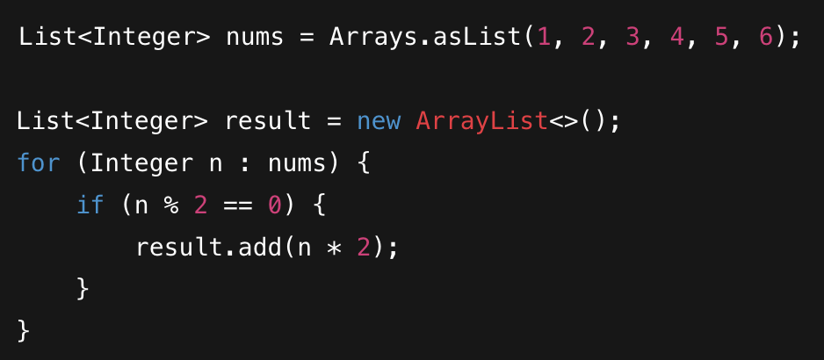
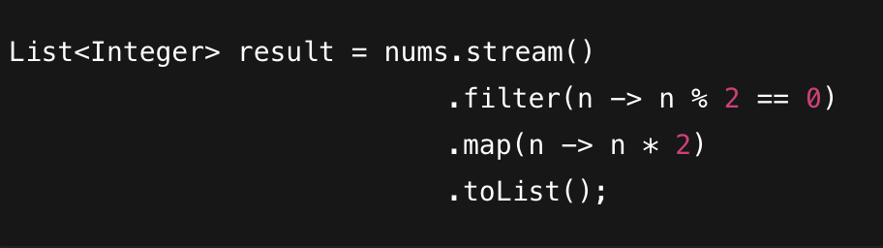
Streams
A Stream lets you process collections declaratively (what to do, not how), using a pipeline of operations.
Streams are not data structures; they are wrappers around data sources that allow us to operate on that data.
3 parts:
Source: List, Set, Array.
Intermediate Operations: filter(), map(), sorted() (They return a new stream).
Terminal Operation: collect(), forEach(), count() (They trigger the processing).

Slide 8
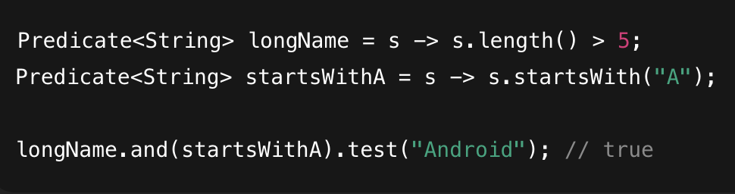
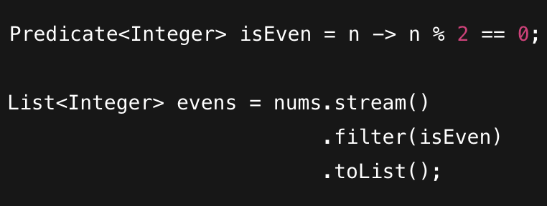
Predicate
A Predicate represents a boolean condition (true / false) on an object.
It’s mainly used for filtering.
Syntax:
Predicate<T> → boolean test(T t)

Slide 9
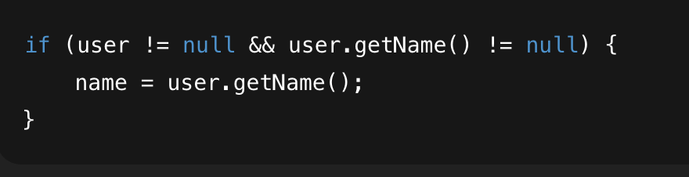
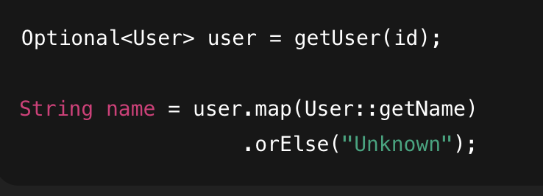
Optional
Optional is a container that may or may not hold a value.
It helps avoid NullPointerException and makes absence explicit.
Instead of returning null, return an Optional container.
Best practices
Use .ifPresent() to execute code only if a value exists.
Use .orElse() to provide a default value.
Use .orElseGet() for lazy.
Example: user.getEmail().orElse("no-email@company.com");

Slide 10
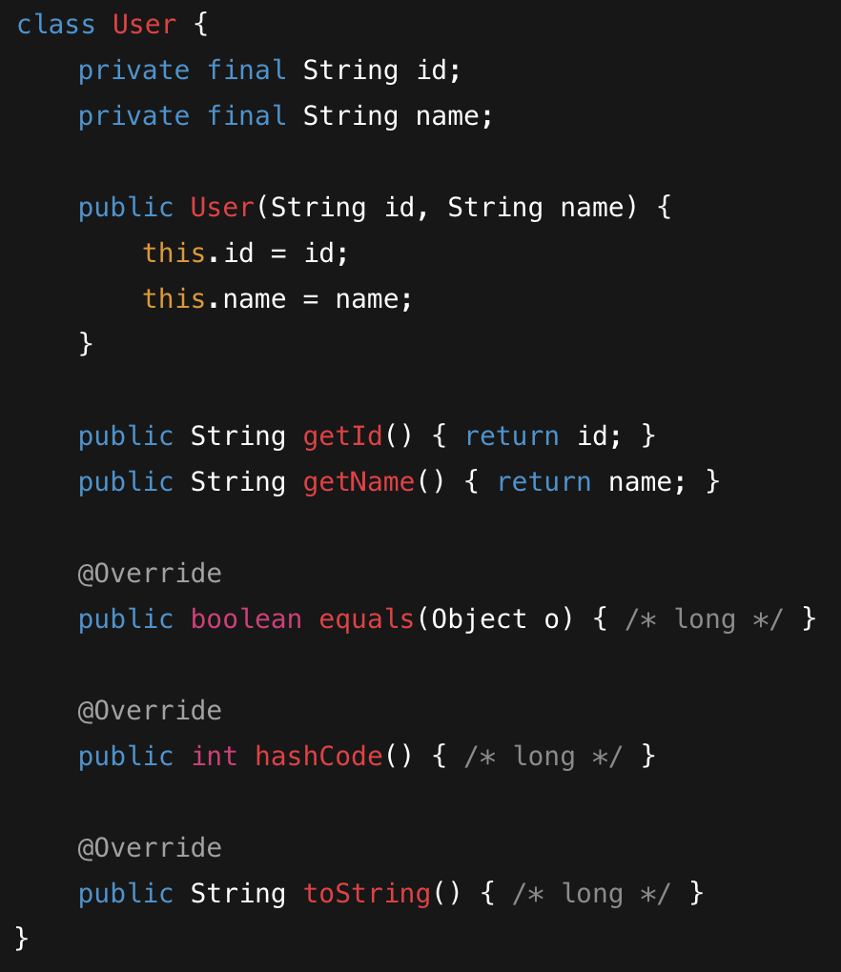
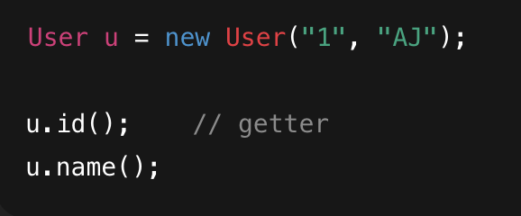
Record
A record is a special class used to store immutable data.
It removes boilerplate for data-carrier classes.

Slide 11
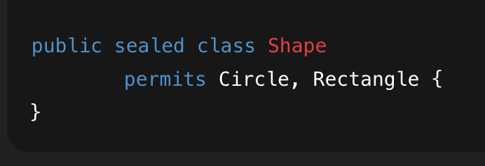
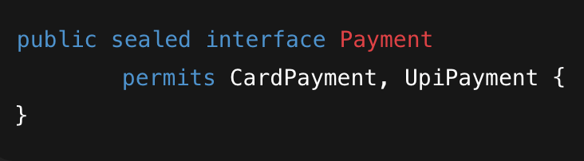
Sealed Class
A sealed class restricts which classes are allowed to extend or implement it.
You explicitly control the inheritance hierarchy.
Keywords: sealed, permits, non-sealed, final
Permitted subclasses must be:
final (no further extension), or
sealed (restrict further), or
non-sealed (open again)

Slide 12
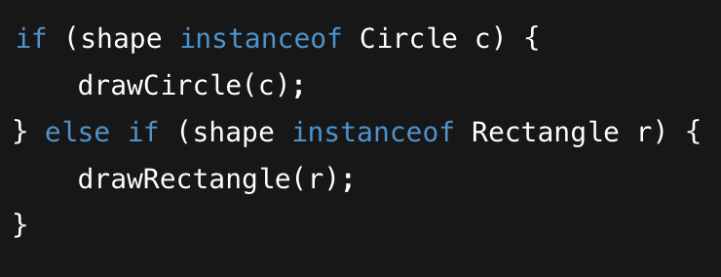
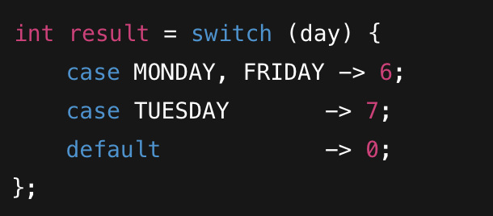
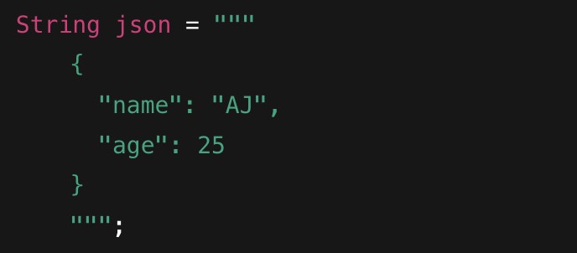
Pattern Matching for instanceof
It lets you check a type and cast it at the same time, safely and cleanly.
Switch is now an expression (it returns a value) rather than just a statement.
It replaces long switch + break logic.
Text blocks allow multi-line strings without ugly escaping.
Syntax - Triple quotes """.

Slide 13
Topics to explore
Design Patterns - Factory, Observer, Strategy, Singleton, Builder, etc.
SOLID principles
MVC pattern
CompletableFuture
Concurrency
Resources
Head First Java Book
Head First Design Patterns Book

Slide 14
Thanks

